Slide 1

KALERWE
C S 509
3 ~ Verses
68.
Nywereranga Ku Katonda Wonna.…
~
Firmly Stand For God…

Slide 2

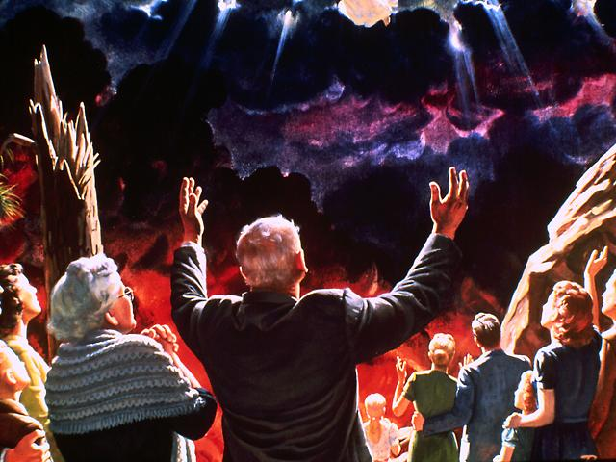
1 of 3 verses
Nywereranga ku
Katonda wonna,
Ne bw’oba ng’oli
mu kabi katya;
Oyo lwe Lwazi
lwaff(e) olw’amaanyi,
Mu buli kabi ko-nna.

Slide 3
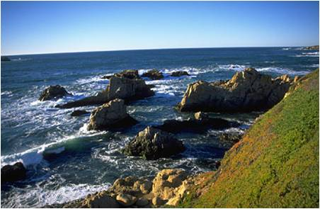
1 of 3 verses
Chorus:
Leka tugumire
nga ku Lwazi lwaffe,
Yesu olwazi lwa-ffe;
Ffe bwe tuguma tuliyimirira,- - -
Mu maaso ge mu kitiibwa.

Slide 4
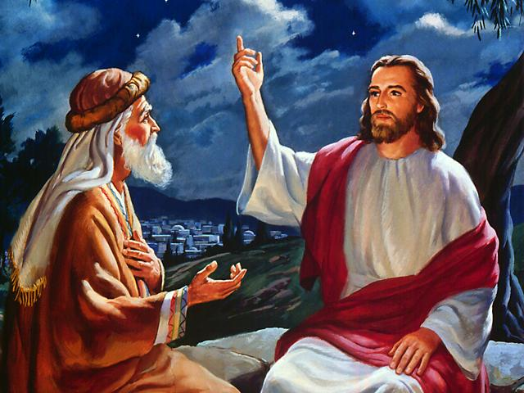
2 of 3 verses
Wonna nywereranga ku kitufu,
Ng’oli mugumu mu kukkiriza,
Oyo lwe Lwazi oluwanguza,
Eggye lyonn(a) ery’omu-bi.

Slide 5
2 of 3 verses
Chorus:
Leka tugumire
nga ku Lwazi lwaffe,
Yesu olwazi lwa-ffe;
Ffe bwe tuguma tuliyimirira,- - -
Mu maaso ge mu kitiibwa.

Slide 6
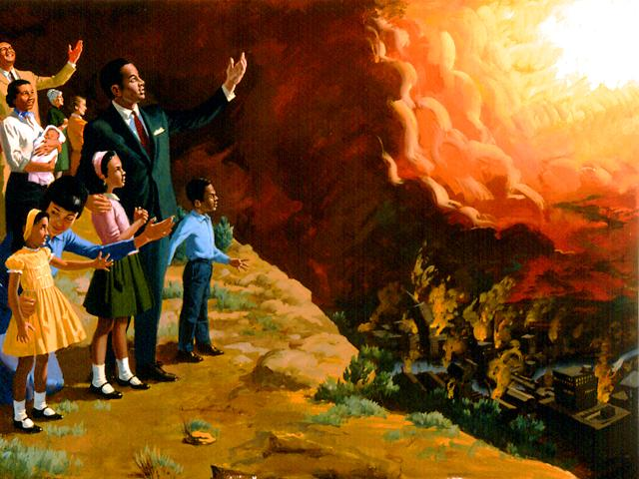
3 of 3 verses
Wonna nywerera
Nga mu mazima,
Byonna byonna birituukirira,
Oyo lwe Lwazi
omul(i) eddembe,
Nga tuwangudde
e-nsi.

Slide 7
3 of 3 verses
Chorus:
Leka tugumire
nga ku Lwazi lwaffe,
Yesu olwazi lwa-ffe;
Ffe bwe tuguma tuliyimirira,- - -
Mu maaso ge mu kitiibwa.

